Slide 1
WELCOME BACK! AFTERNOON AGENDA
13.00 – 14.00
Lessons learned until now – labour inspectorates
What are the specific challenges regarding GIG for labour inspectorates?
Iceland
Finland
Sweden
14.00 – 14.40
Short break and work shop
– country wise
Conclusions to be put down in writing
14.40 – 15.20
Reconvene and each country presents their findings
15.20 – 15.30
Summing up and final remarks

Slide 2
Lessons learned until now – labour inspectorates
Iceland
- Sandra Heimisdóttir Vinnueftirlitið | Administration of Occupational Safety and Health
Finland
- Riku Rajamäki
Regional State Administrative Agency for Southern Finland/Division of Occupational Health and Safety
Sweden
- Sara Svensson, Mattias Karlsson
Swedish Work Environment Authority
- Lisa Hemph and Rebecca Filis
Swedish Public Employment Service & Swedish Tax Agency

Slide 3
GIG-economy and labour inspection in Iceland
Sandra Heimisdóttir
Administration of Occupational Safety and Health

Slide 4
Administration of Occupational Safety and Health in Iceland (Vinnueftirlitið)
Act on Working Environment, Health and Safety in Workplaces, no. 46/1980
Article 2(1): “This Act covers all activities, where one or more persons are employed, whether they are owners of the enterprise or employees.”

Slide 5
Specific challenges regarding GIG for labour inspectorates
Lack of data
Identification
Platform workers
Self-employed
Timeframe of projects
Location of physical work environment
Temporary
Homes
Own personal space
Other spaces, e.g. cafés

Slide 6
Thank you for your attention!

Slide 7
Gig Economy – with focus on ”light entrepreneurship” at inspections
Regional State Administrative Agency for Southern Finland/Occupational Health and Safety
Senior Inspector Riku Rajamäki

Slide 8
Specific challenges
Intensive marketing on ”light entrepreneurship’s” benefits
From labour inspectorate’s perspective, a new tendency to turn normal paid work into entrepreneurship – to the situations where it doesn’t fit
Most common sectors where ”light entrepreneurship” seen problematic: construction, cleaning, car washes, restaurant

Slide 9
Specific challenges
Several cases where in paper self-employed foreign persons have thought to be in an employment relation => often no real characteristics of entrepreneurship
Important consequences to ”light entrepreneurs”:
Residence permits, social security benefits, accident insurance etc.
Work discrimination not applicable to entrepreneurs
Often ”light entrepreneurship” as a way to avoid compulsory employer’s fees

Slide 10
Case example: food couriers
Several reports from other authorities to LI of Southern Finland about foreign food couriers without any permit to work and reside in Finland
Labour legislation and Finnish Aliens’ Act concerning employers applicable only when employment relation
Inspections to two separate food courier companies in order to establish whether employment or entrepreneurship
Assignment contracts between food delivery companies and food couriers

Slide 11
Employment contracts definition in Finland
“ This Act applies to contracts (employment contracts) entered into by an employee, or jointly by several employees as a team, agreeing personally to perform work for an employer under the employer's direction and supervision in return for pay or some other remuneration.”
All criteria must be met if employment relation

Slide 12
Case example, food couriers: findings of inspections
Assignment contracts between food delivery companies and food couriers with predefined set fees
Electronic applications used by couriers where they could accept delivery assignments
Food delivery companies’ point of view: not an employment relation as work not done under the direction and supervision of the company
Other criteria matched with Finnish Employment Contracts Act

Slide 13
Case example, food couriers: Labour Council’s opinions
LI of Southern Finland asked Finnish Labour Council for opinions about the applicability of Finnish Working Hours Act to food courier companies’ inspections
Labour Council cannot give legally binding interpretations; however, they have value in legal processes
Working Hours’ Act only applies to employment relations => therefore Labour Council needed first to establish whether work was done in employment relation
After 9 months, Labour Council gave opinions on both cases, they voted on their opinion (6-3 in favour of employment relation)

Slide 14
Case example, food couriers: Labour Council’s opinions
Labour Council’s main points in opinions:
If willing, do the companies have a possiblility to influence the way couriers carry out their work, time and place after the gig has been accepted?
If willing, do the companies have a possibility to supervise that couriers act according to intructions given by company?
Labour Council with 6-3 decision: digital application allows companies to direct and supervise couriers’ work, couriers had written instructions on how to make deliveries

Slide 15
Case example, food couriers: Labour Council’s opinions
In general, Labour Counclil saw no clear signs of entrepreneurship:
Food couriers’ services not offered simultaneously to many delivery companies in practice
Couriers didn’t negotiate delivery fees with companies
Fees offered to couriers not on such a high level, that pension and insurance fees could be thought to be covered by couriers themselves
Disagreeing opinions in Labour Council: 3 voted from employer’s side in favour that direction and supervision criteria didn’t exist in these cases

Slide 16
What’s next with the cases?
Improvement notices on working hour register given in inspection reports to the companies
Deadline of improvement notices expiring in May-21 (6 months’ time to start obeying improvement notices)
If not obeyed, then administrative process where companies can be obliged to start obeying improvent notices
Employers do have the possibility to appeal to administrative court on the decisions
It is probable that the companies might still question the outcome => appealing highly probable

Slide 18
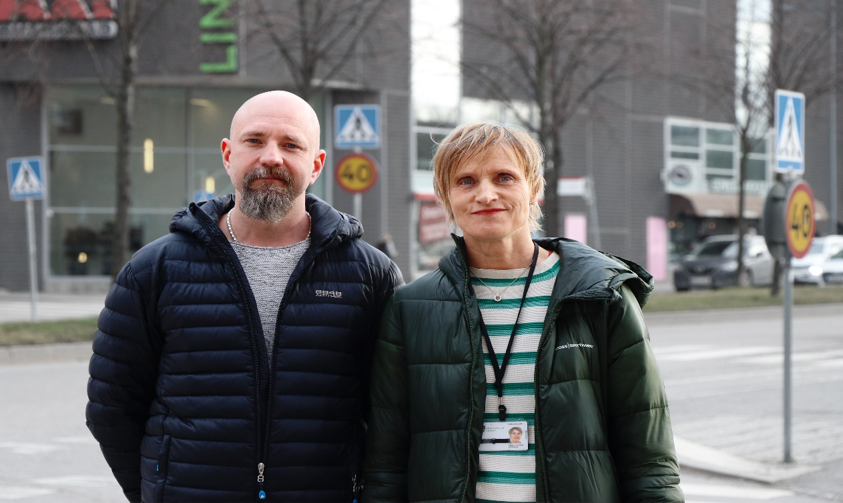
New ways of organising work
Swedish Work Environment Authority
2021-02-17
Mattias Karlsson och Sara Svensson
Notes:
Hi my name is Mattias Karlsson and I work as a inspector at the authority since 4 years. My work place is the region west and I am thus stationed in Mölndal, just outside of Gothenburg. I work mainly with planned inspections. I will give this presentation together with my colleague Sara Svensson who will present herself – please Sara!

Slide 19
The project: new forms of organising work
A government assignment to be reported back in February 2022 (extended due to corona)
The purpose is to gain knowledge of whether the work environment is satisfactory in this type of work.
The aim is to test whether the work environment legislation in its current form is sufficient to make demands for improvements where necessary.
Two inspectors, a project manager, a lawyer and a communicator.
Project Directive 2018/035377.
Limited to the Work Environment Act (AML) with a focus on systematic work environment work (SAM).
Notes:
Our supervisory effort is a pilot project that focuses on new ways of organizing work with a focus on self-employment companies and digital platforms. We have been commissioned by our government and it will be reported back in February 2022. The purpose of the supervision is to gain knowledge if the work environment is satisfactory in this type of work and the goal is to test whether the work environment legislation in its current form is sufficient to demand improvements where it is needed. The work is carried out for the most part by the members of our project group, which consists of me and Sara as inspectors, a project manager Monica Björk, a lawyer Jonas Hamark and a communicator Anna-Carin Carlsson. For those who want to read more, there is a project directive with registration number 2018/035377, there is also more information on our website. In the project, we have chosen to make a limitation to the Work Environment Act with a focus on systematic work environment work. Now Sara takes over, go ahead Sara.

Slide 20
Inspections – the way it works
A regular inspection:
We meet an employer at the workplace where the employer knows what the employee is working on and where the work is performed. We also meet workers.
We know that the Work Environment Act and our regulations apply to the employer.
Inspections of digital platforms and self-employment companies:
We meet the owner / owners of the company, but never see the workplaces where
the work is performed. We do not meet those who do the work.
Several of the companies we have met would like to know what applies and what responsibility they have.
In this project, we do not know if the Work Environment Act applies.
Notes:
This means that we neither meet those who perform the work nor see the place where the work is performed. We meet the owner and any administrative staff working in the office.
In a regular inspections, we put many requirements both on the basis of SAM and other regulations. We have been open about the fact that we do not know if the legislation can apply and that this is the reason for this pilot project.
Many of the companies we visit want to know what applies and what responsibility they have.

Slide 21
Inspections done so far
We have carried out 25 inspections, most of which have led to demands for action.
Since March 20, 2020, no inspections have been carried out due to pandemic.
3 businesses have been fined: 2 digital platforms and 1 self-employed company.
The digital platforms have appealed the decision with justification as to why they do not consider themselves to have employer responsibility for the work environment.
The requirements are set on the basis of the regulations on systematic work environment work, AFS 2001:1.
The decision against the self-employment company has been revoked due to a ruling from the Court of Appeal in October 2019. The Swedish Work Environment Authority appealed the ruling, but the Supreme Administrative Court decided in January 2021 not to grant leave to appeal.
Notes:
Here is some information about the supervision and the results we have achieved so far. We have carried out 25 inspections, most of which have led to demands for action. Due to the pandemic that has affected us all, no inspections have been carried out since March last year. Three businesses have been fined, of which two are digital platforms and one is self-employed company. The digital platforms have appealed the decision with justification as to why they do not consider themselves to have employer responsibility for the work environment. The requirements are set on the basis of the regulations on systematic work environment work, AFS 2001:1. The decision against the self-employment company has been revoked due to a ruling from the Court of Appeal in October 2019. The Swedish Work Environment Authority appealed the Court of Appeal's ruling, but the Supreme Administrative Court decided in January 2021 not to grant leave to appeal. With the decision of the Supreme Administrative Court, the judgment of the Court of Appeal stands.
Now I hand over the word to Sara, go ahead Sara.

Slide 22
Challenges
Difficult to assess responses to risk assessments.
Post-registered assignments.
Some have the will to do the right thing but do not know how to.
Foreign-registered companies.
We do not meet contractors / workers.
Notes:
How do we assess risk assessments when you have not been out at the workplaces where the work is performed, but you have made risk assessments based on facts that can be downloaded online, among other things. The employees / performers of the work have not participated in the risk assessments.
Having post-registered assignments means that, for example, the self-employment companies do not know where the people are going to work until they receive documentation and sends out an invoice.
How should one then be able to take on employer responsibility and how should one, for example, be able to make a risk assessment of a job that the self-employed company does not know about until the job has been completed?
Several of the companies are interested in our assignment and are asking for answers on how they should/could do the right thing.

Slide 23
What happens now?
We will carry out distance follow-ups on the companies that have received demands to follow requirements from our side.
We will resume physical inspections when the situation in society allows.
Two companies have appealed the injunctions with a fine and these appeals have been forwarded to the administrative court.
Notes:
The companies are so-called digital platforms. We are waiting for an answer.

Slide 24
Giglab Sweden is a policy initiative advocating sustainable growth of the gig economy in Sweden
Webinar, 17 FEBRARY 2021

Slide 25
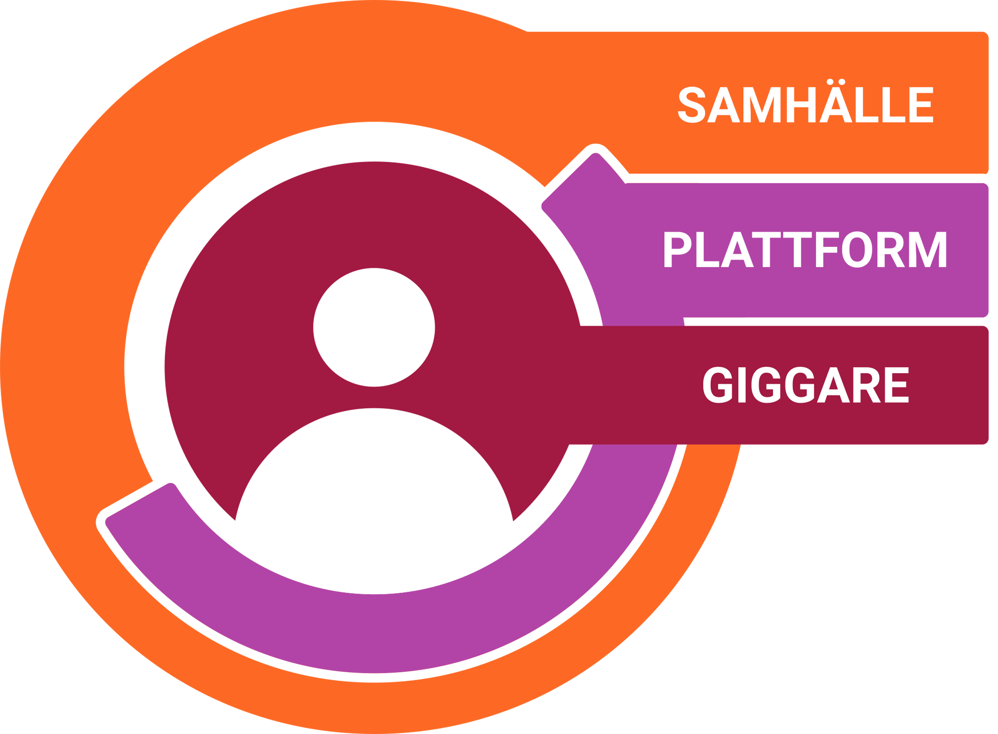
INTRO
Rebecca Filis – Swedish Tax Agency
Head of the Tax Agency´s task group for the analysis of how the Sharing Economy effects the tax system, and has since then been engaged in questions concerning the tax challenges that appears in new business models and gig economy.
Lisa Hemph – Swedish Employment Service/Jobtech dev
Focus on dataportability in the gigeconomy and “How online reputation scores within the gig economy may contribute to a more inclusive labor market and increasingly empowered workers”

Slide 26
GIGLAB SWEDEN
Giglab Sweden is a national policy lab and a collaboration between Jobtech dev/Swedish public employment service,
The Swedish tax authorities, Coompanion, Stockholm Scool of Economics and SVID, the Swedish Industrial Design Foundation.
Our ambition is to work together for a sustainable growth of the gig economy in Sweden.

Slide 27
OBJECTIVES
Developing a body of knowledge on sustainable solutions for gig workers, by testing prototypes and using the outcomes to support discussions about policy options in the gig economy.
Input in ongoing work towards Agenda 2030, focus on better working conditions and digital infrastructure linked to the gig economy
Basis for continued internal work at the authorities linked to the gig economy
Empirical basis for research in the field of gig economics, conducted by Postdok researcher Claire Ingram Bogusz at the Stockholm School of Economics

Slide 28
MAPPING USING SYSTEM APPROACH
During 2020, we have mapped obstacles/challenges within the Gig Economy system; through giglabsverige.se and four digital workshops.
To create an understanding of the perspectives of different actors. Identify mesaures in order to achieve change in the system for a sustainable gig.

Slide 29
SUSTAINABLE COMPONENTS
Power balance
Sustainability in the balance of power between platforms/gigworkers
Social security
Sustainability in the transformation to more adapted security systems including gigworkers .
Lifelong learning
Sustainability to embrace opportunities to achieve lifelong learning.

Slide 30
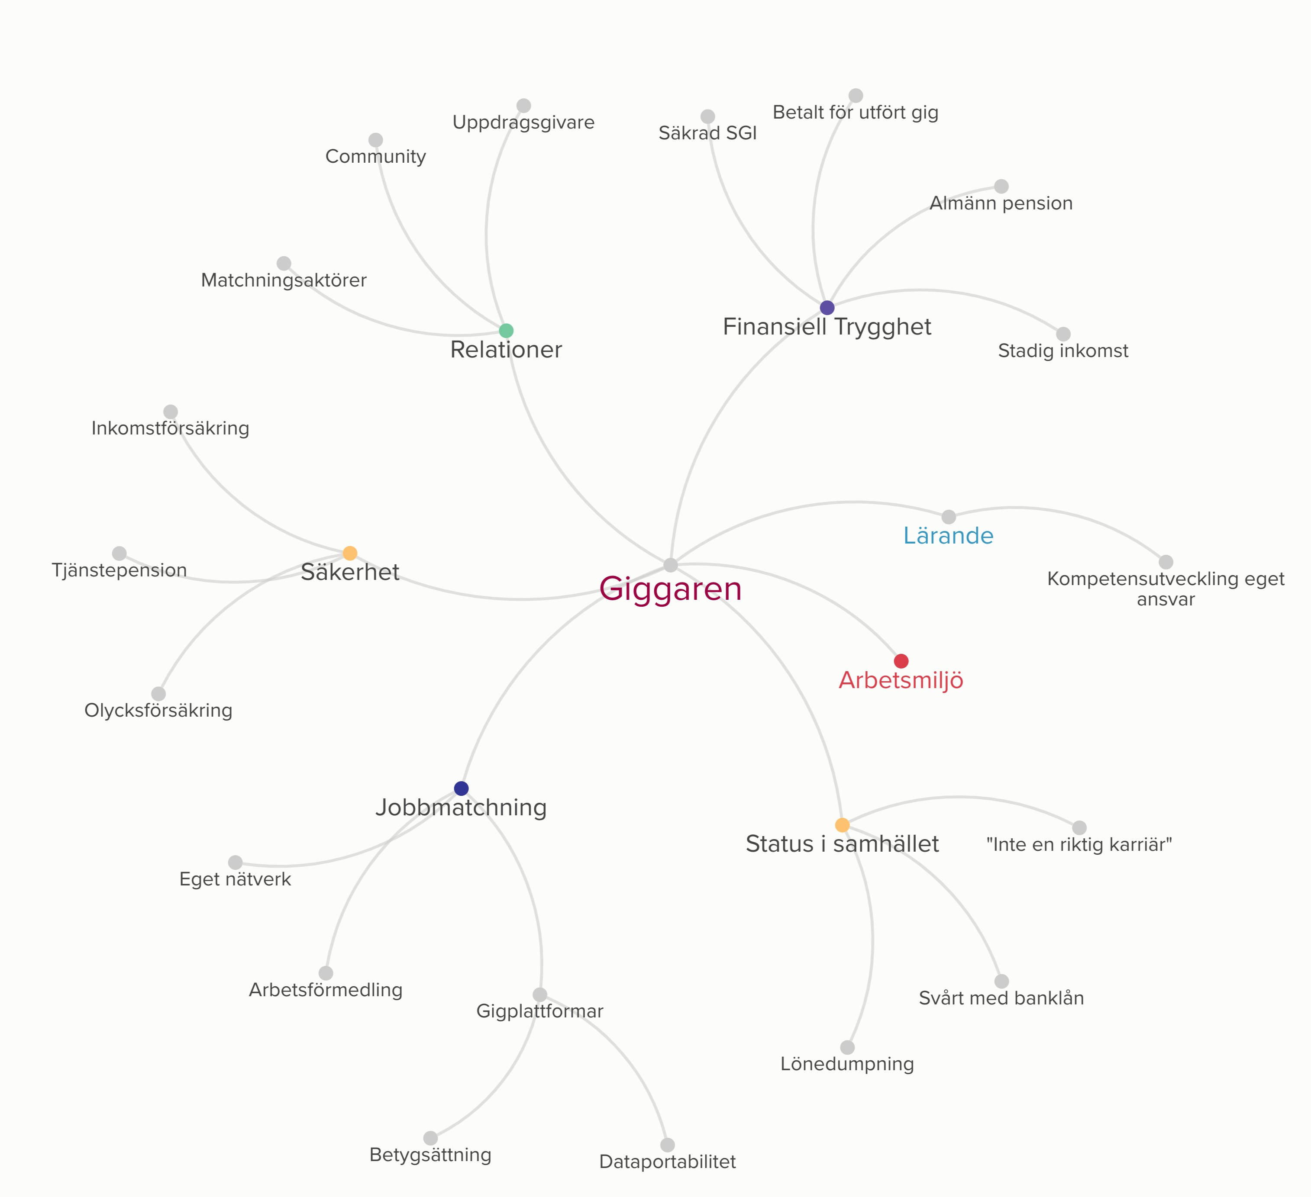

Slide 31
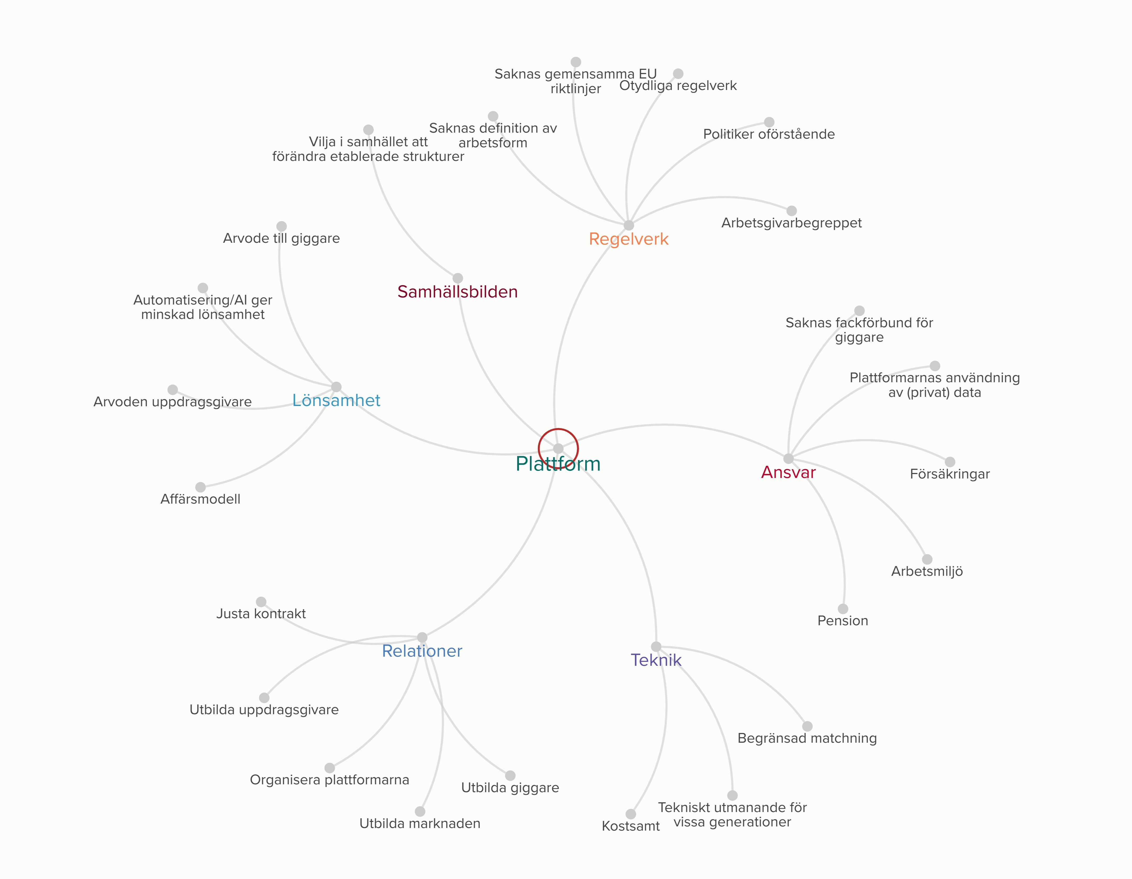

Slide 32
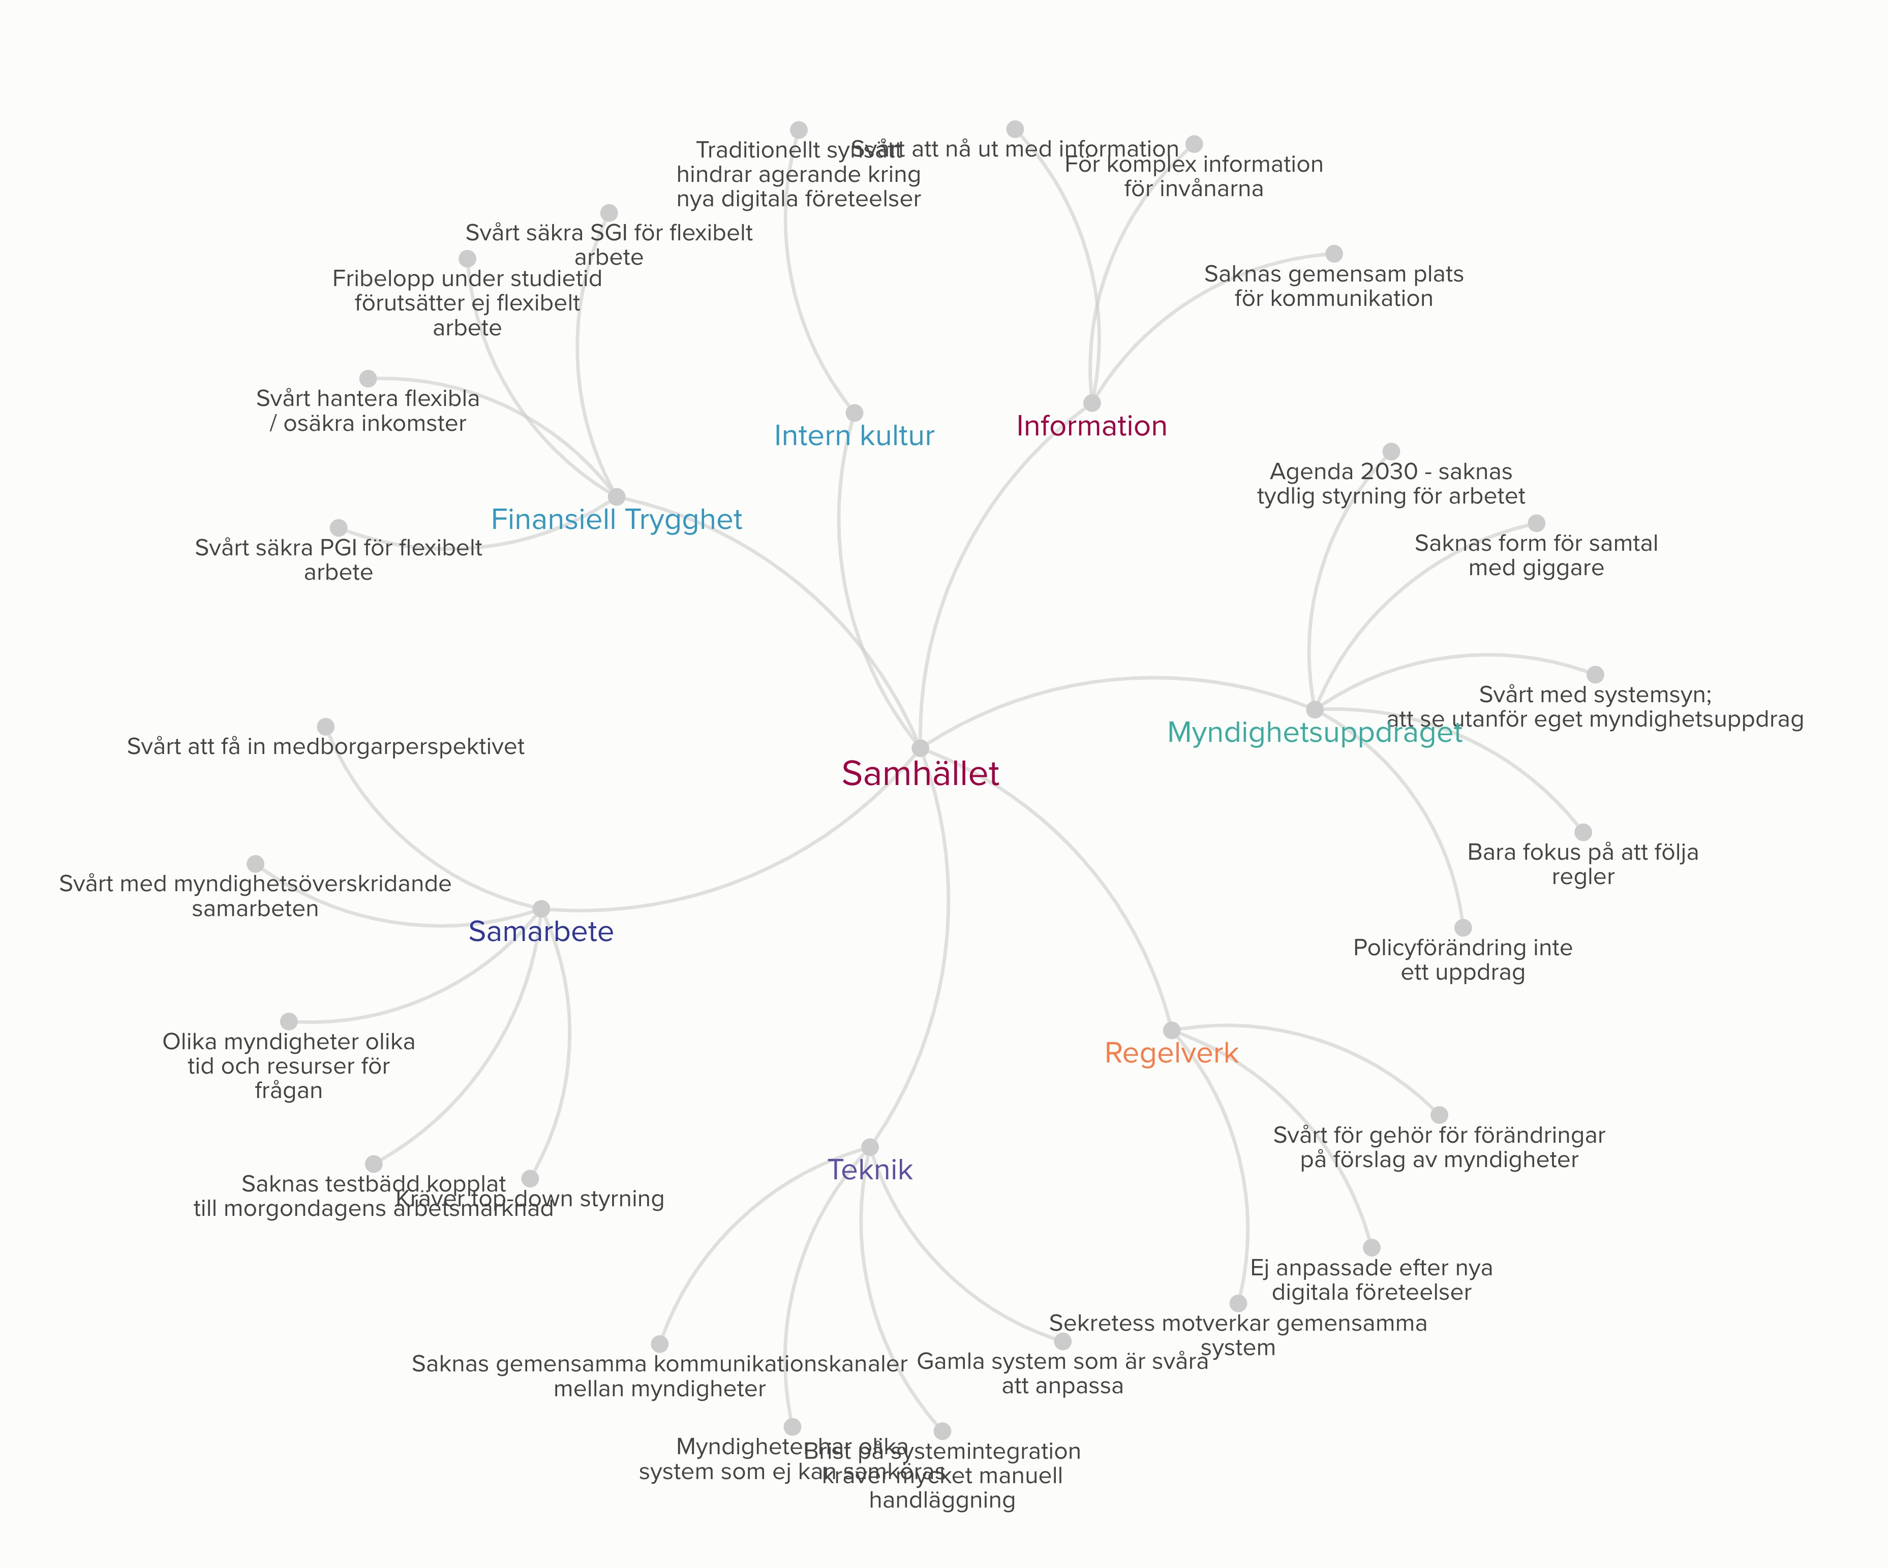

Slide 33
EXAMPLES OF PROPOSALS
A joint portal for cooperation, discussions, development and test beds
Explore a new Swedish model for the labour market
Union for gigworkers
A new model of skillsmapping for sustainable digital matching

Slide 34
NEXT STEP
Giglab Report to be launched in February
Let us know if you are interested to continue the dialouge. Contact: rebecca.filis@skatteverket.se, lisa.hemph@arbetsformedlingen.se
www.giglabsverige.se
THANK YOU!

Slide 36
Questions at hand
What are the challenges that we should prioritize at inspections (“GIG-working environment”)? What measures should be taken?
What are the specific obstacles to overcome for successful national cross-agency inspections and activities regarding GIG? How do we establish good cooperation? What kind of tools should be used and why/when? E.g. by prevention, deterrence?
What is the added value of finding a well-functioning cross-border collaboration regarding GIG?
Tripartite cooperation, how do we engage social partners to be active?

Slide 37
Welcome back! Was it a good discussion?
Estonia
Latvia
Iceland
Finland
Denmark
Sweden
Norway

Slide 39
End of the day...finally...
Thank you for attending – you will recieve this presentation via e-mail – together with a written summary of todays presentations and conclusions.
Please stay in touch!

